Slide 1
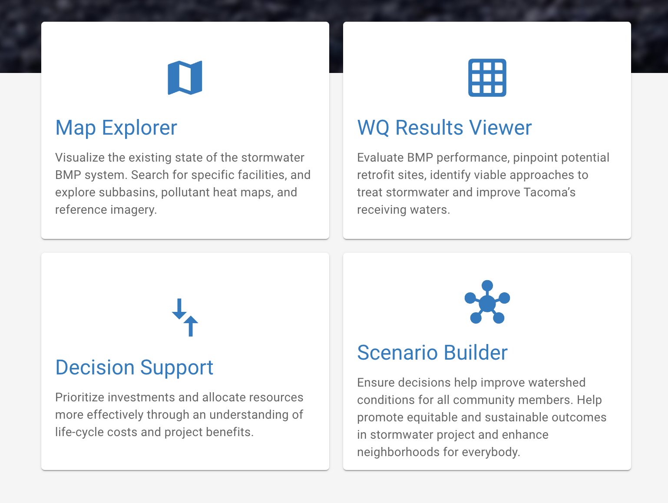
Tacoma Watershed Insights Main Components

Slide 2
System Administration

Slide 3
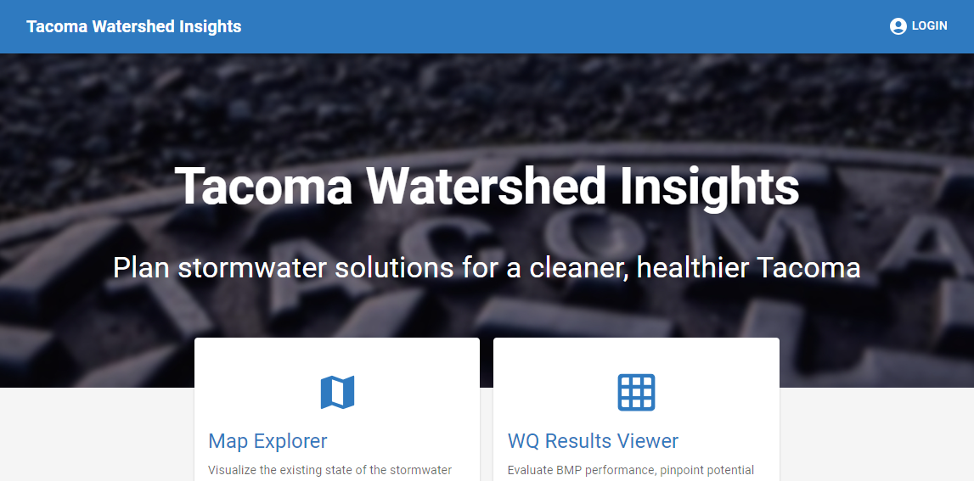
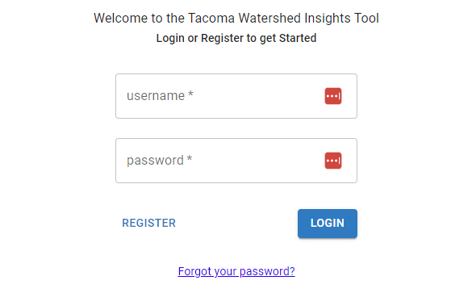
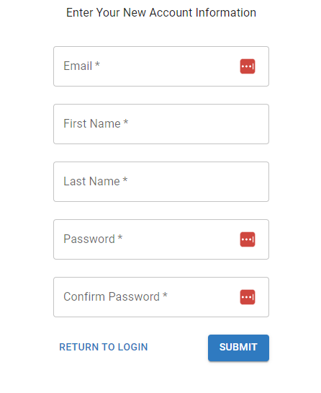
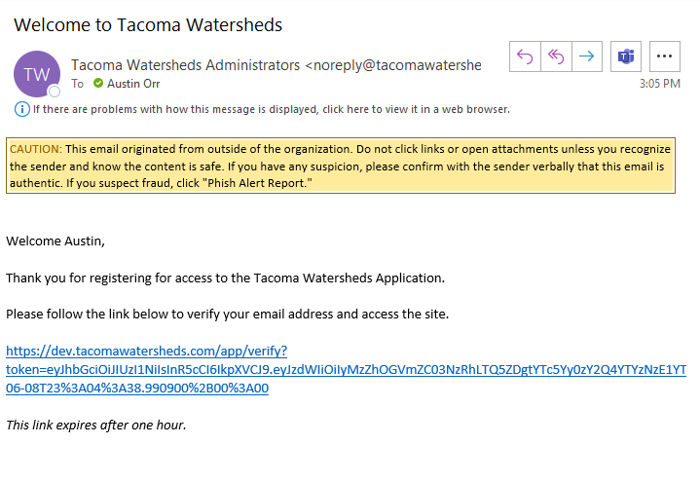
Enroll New User
Navigate to site
Click Login
Click Register
Click Submit
Check Email & Click through Verification

Slide 4
Modify User Roles
Role | Permission
Public | None
Read-only | Read access to data via site and via token
User/Editor | All of the above + access to scenarios and editing data
User Admin | All of the above + access to user manager + access to application settings
System Admin | All of the above + direct api access

Slide 5
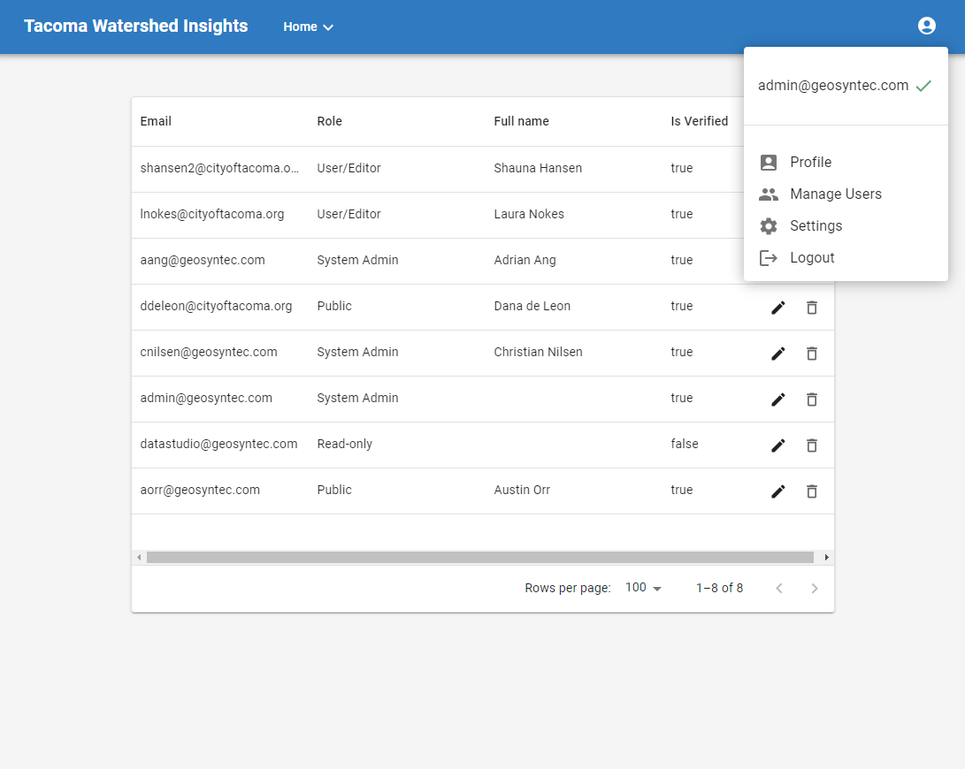
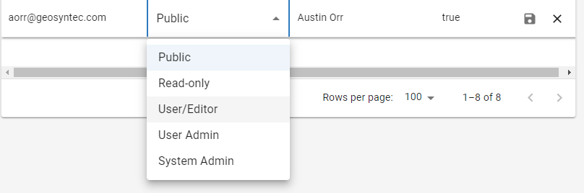
Modify User Roles
Ask a User Admin to change your role
Click on Profile
Click Manage Users
Click the pen to edit
Select Role
Save or cancel

Slide 6
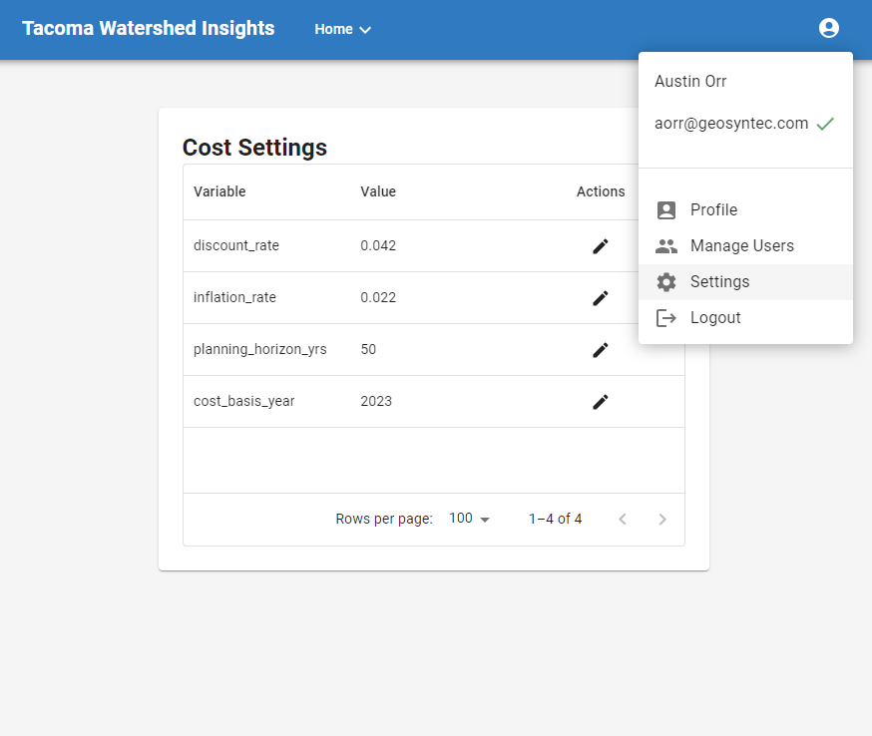
Cost Module Settings
Modify Global Settings

Slide 7
Map Explorer

Slide 8
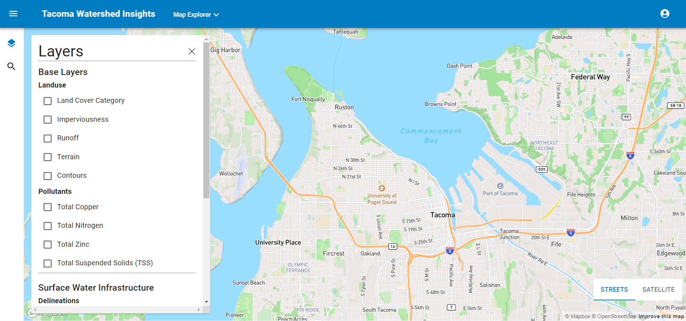
Visualize Existing Infrastructure and Conditions
Available Layers:
Pollutant heat maps
Landuse/Terrain
Stormwater subbasins
Stormwater BMPs
Stormwater pipes

Slide 9
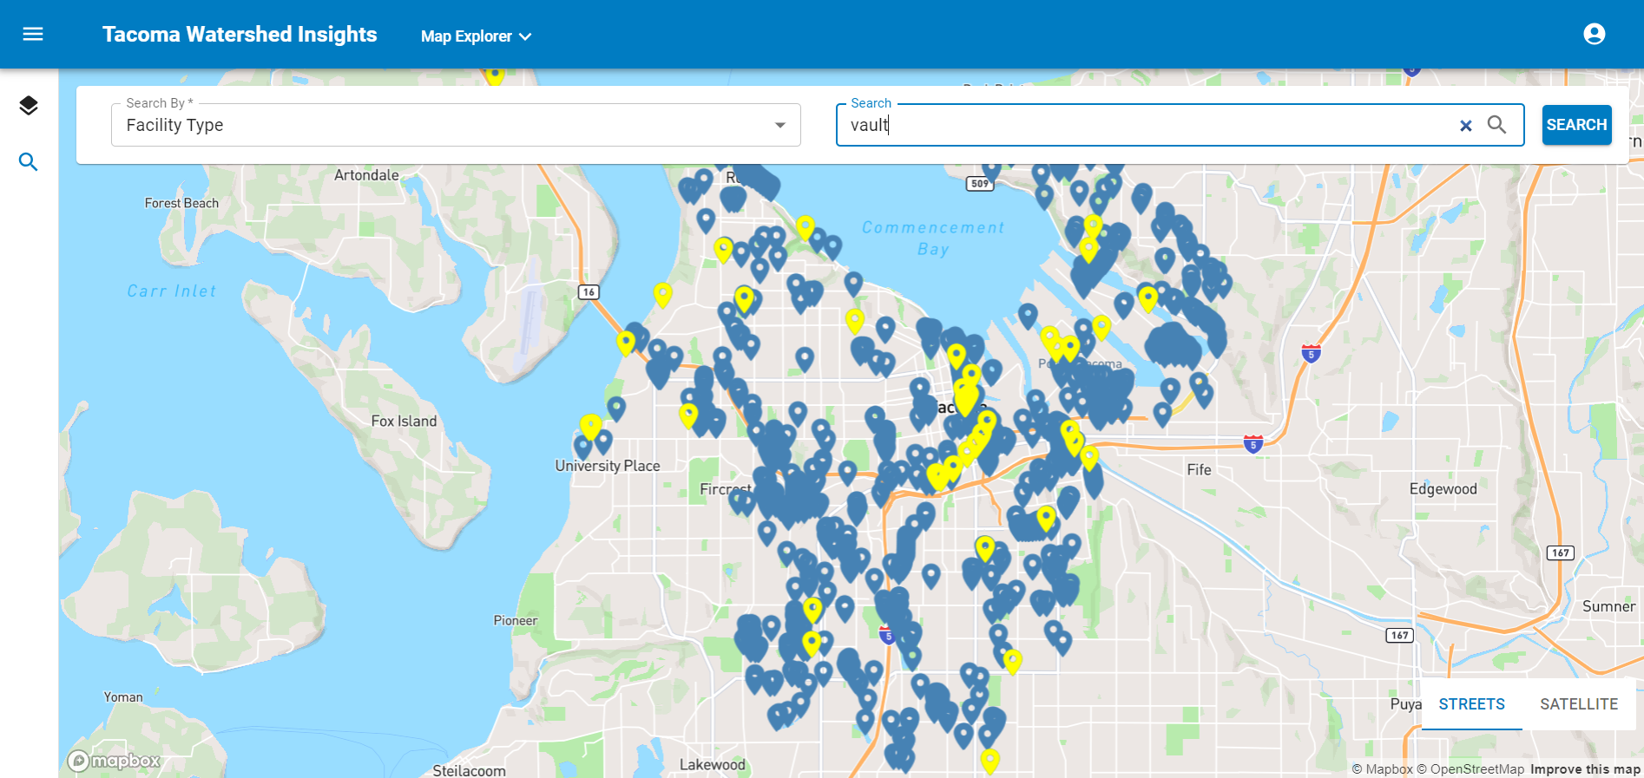
Search by Facility Type

Slide 10
Results Reviewer

Slide 11
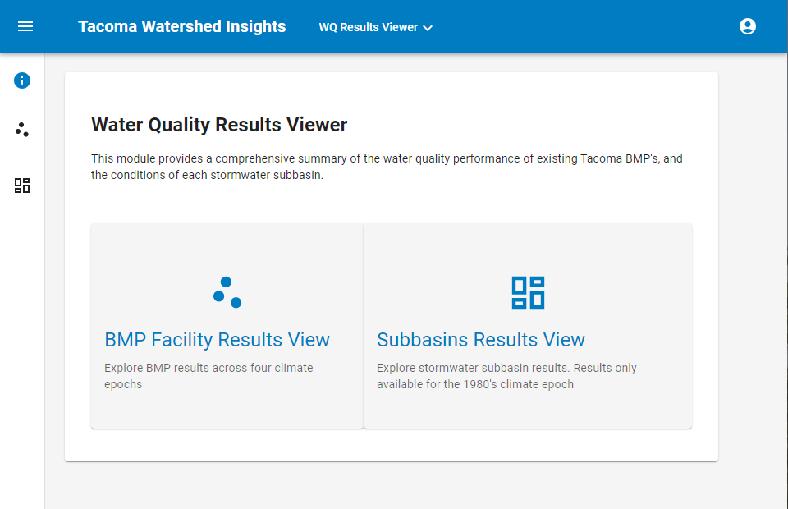
Explore WQ Performance at Facilities and Subbasins

Slide 12
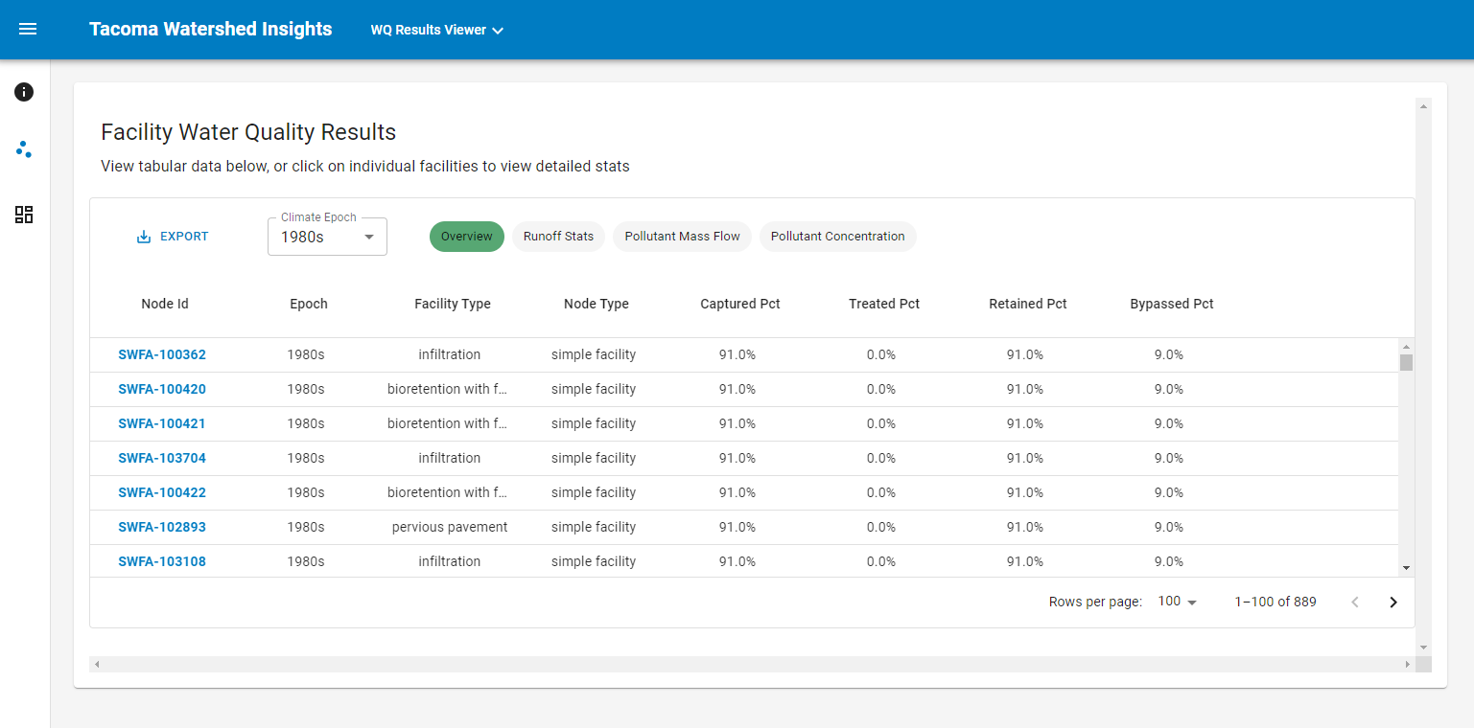
Explore BMP Attributes
Link to individual facility details
View stats by climate epoch and type

Slide 13
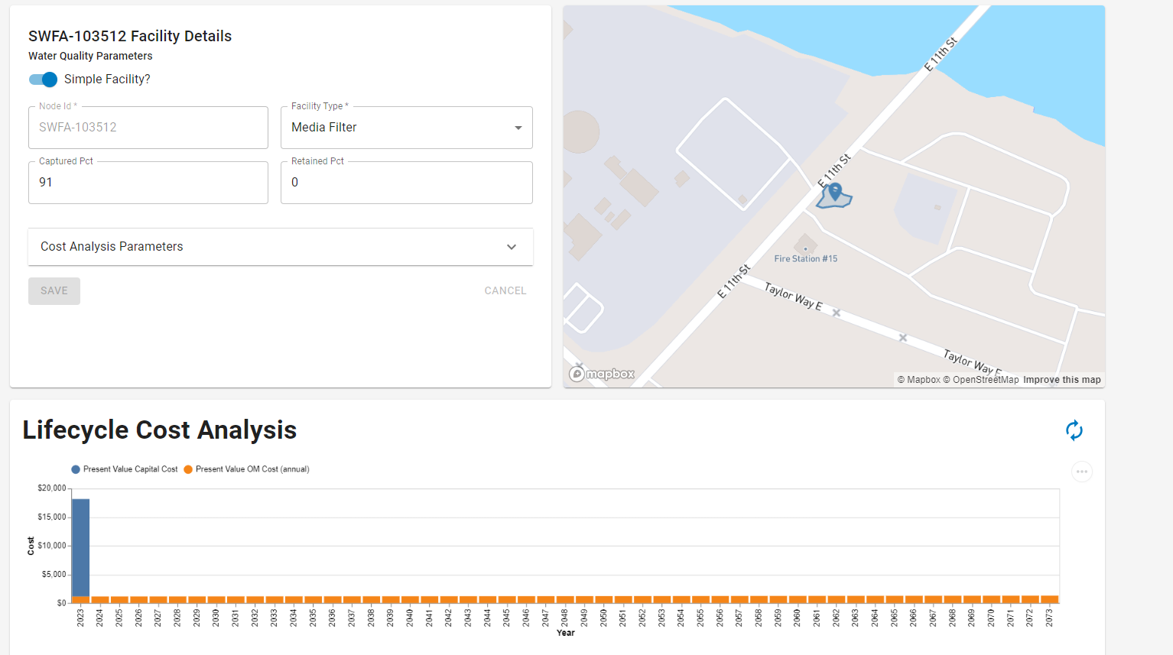
Drill down to individual BMPs

Slide 14
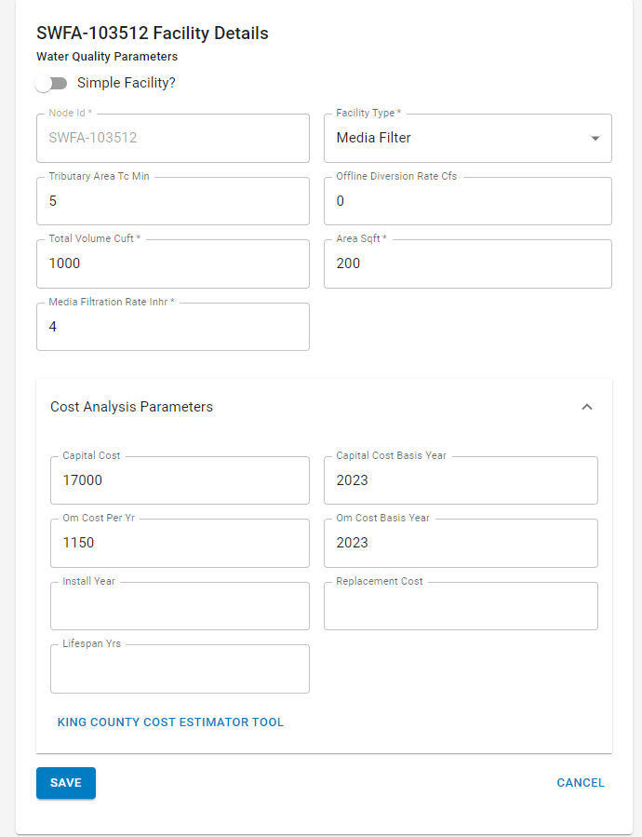
Create BMPs with Detailed Performance and Cost Attributes
Toggle between ‘simple’ facilities driven by percentage based capture and treatment stats to ones based on physical attributes
Add cost data that allows for capital and O&M costs to be amortized over the lifespan of the facility

Slide 15
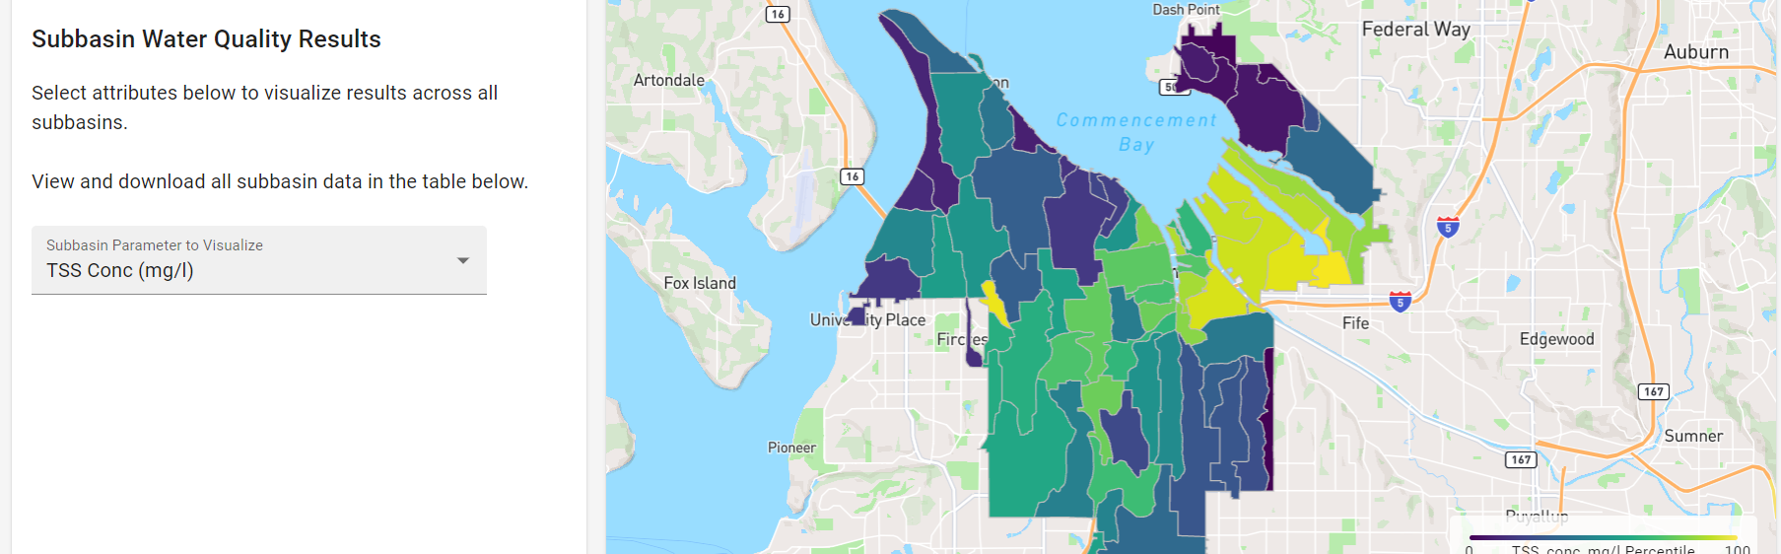
Visualize Subbasin Attributes
Available Parameters:
-Land Use/Cover
-Runoff
-Treatment Facility Summary
-Pollutant Concentrations/Reductions

Slide 16
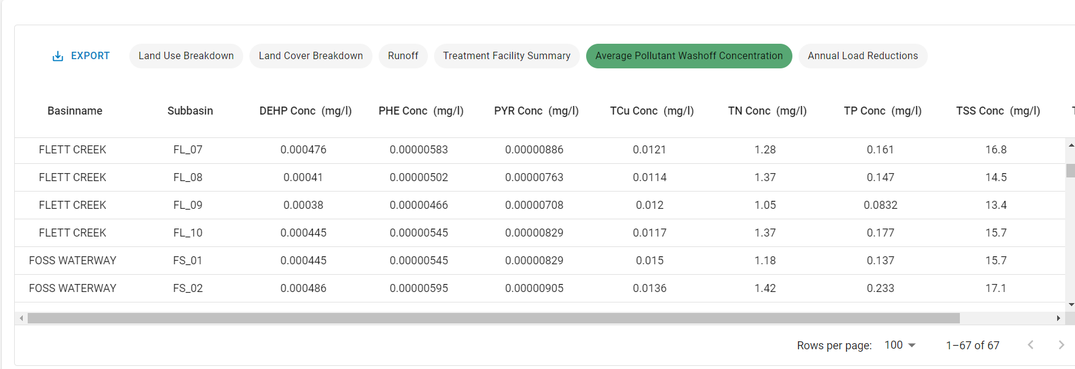
Visualize Subbasin Attributes
View and download tabular results

Slide 17
Scenario Builder

Slide 18
Purpose and Process
Allows users to model a proposed single BMP facility with an upstream delineation
Scenarios can be designed incrementally (facility/delineation can be added after creation)
WQ results can be generated after scenario creation and future edits

Slide 19
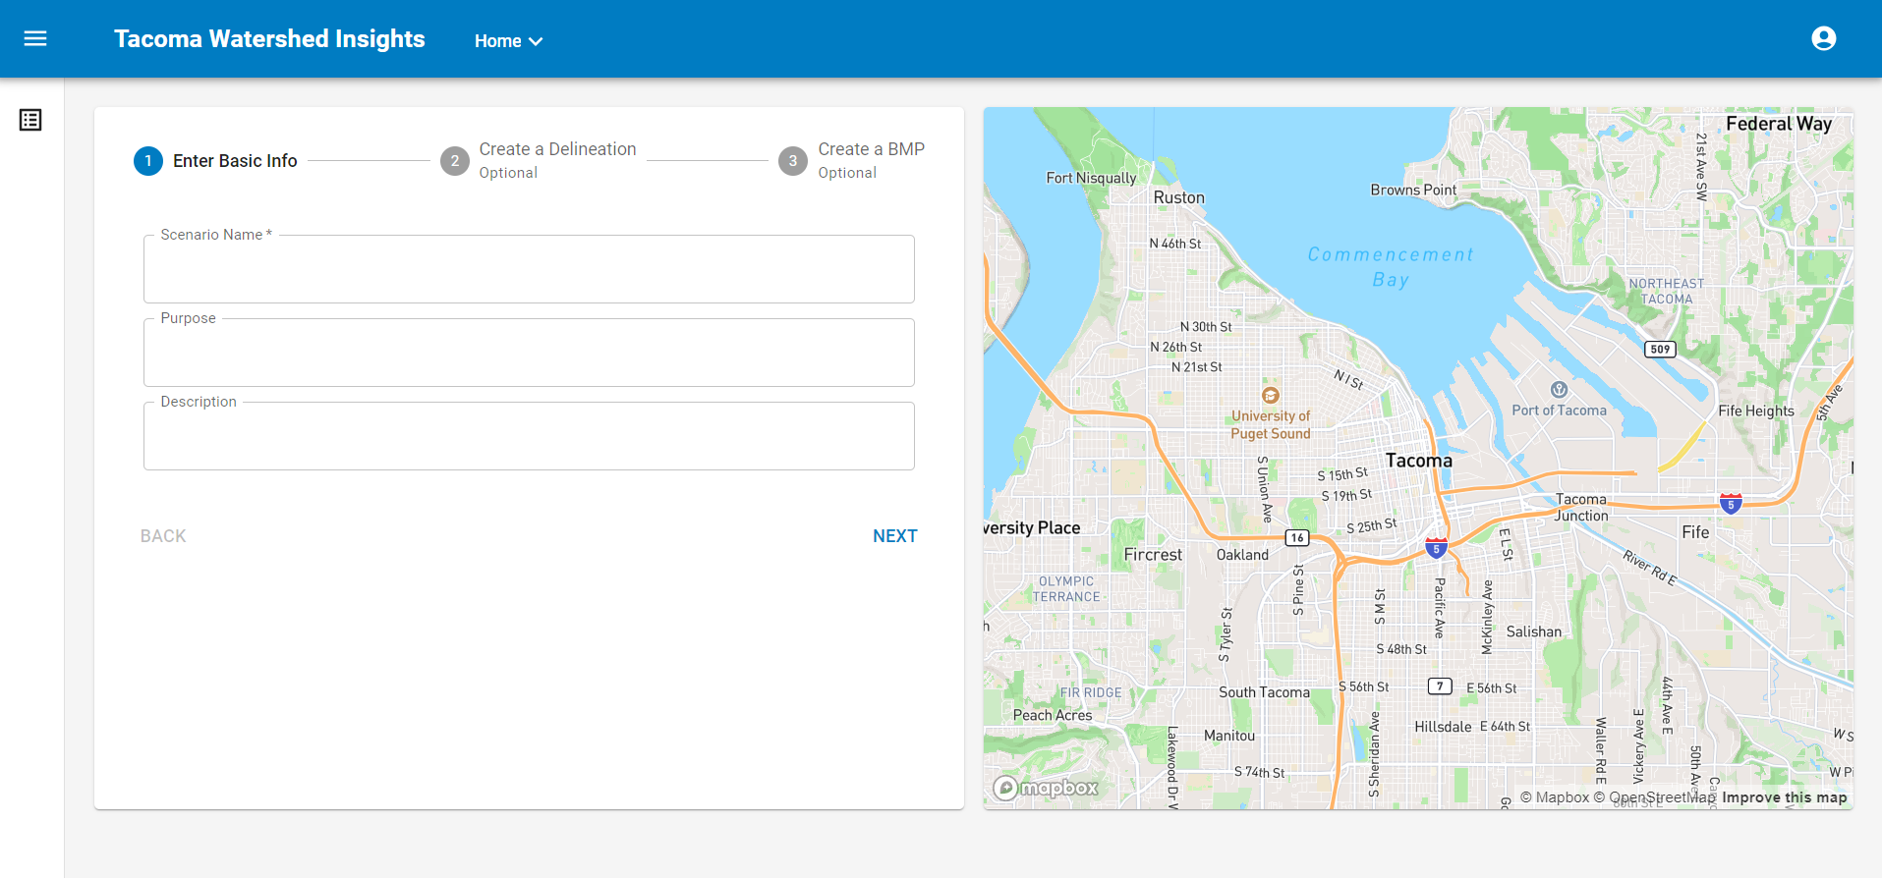
Scenario Design Process

Slide 20
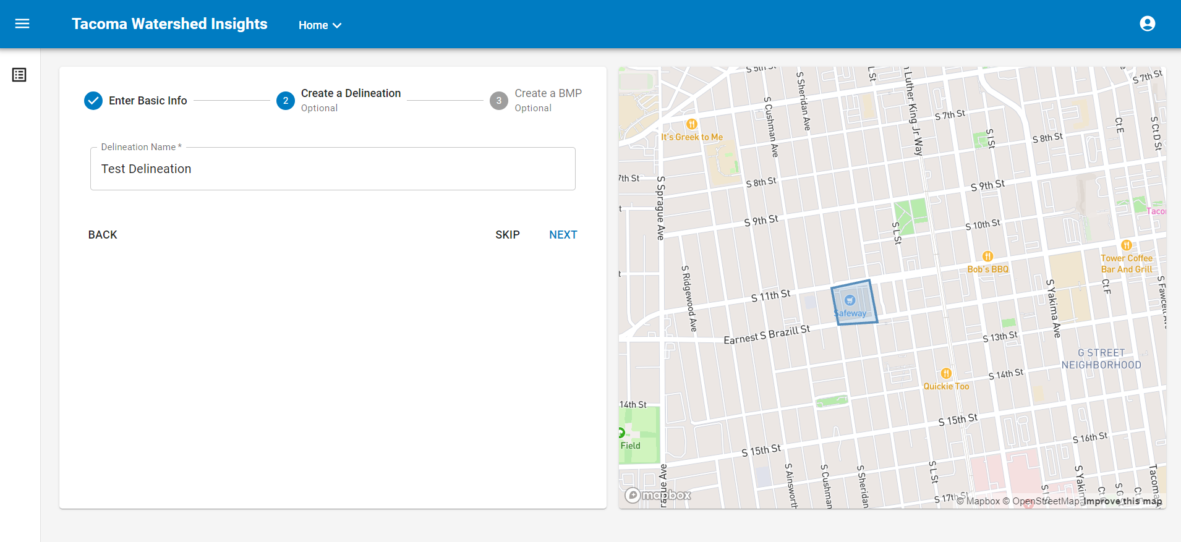
Scenario Design Process

Slide 21
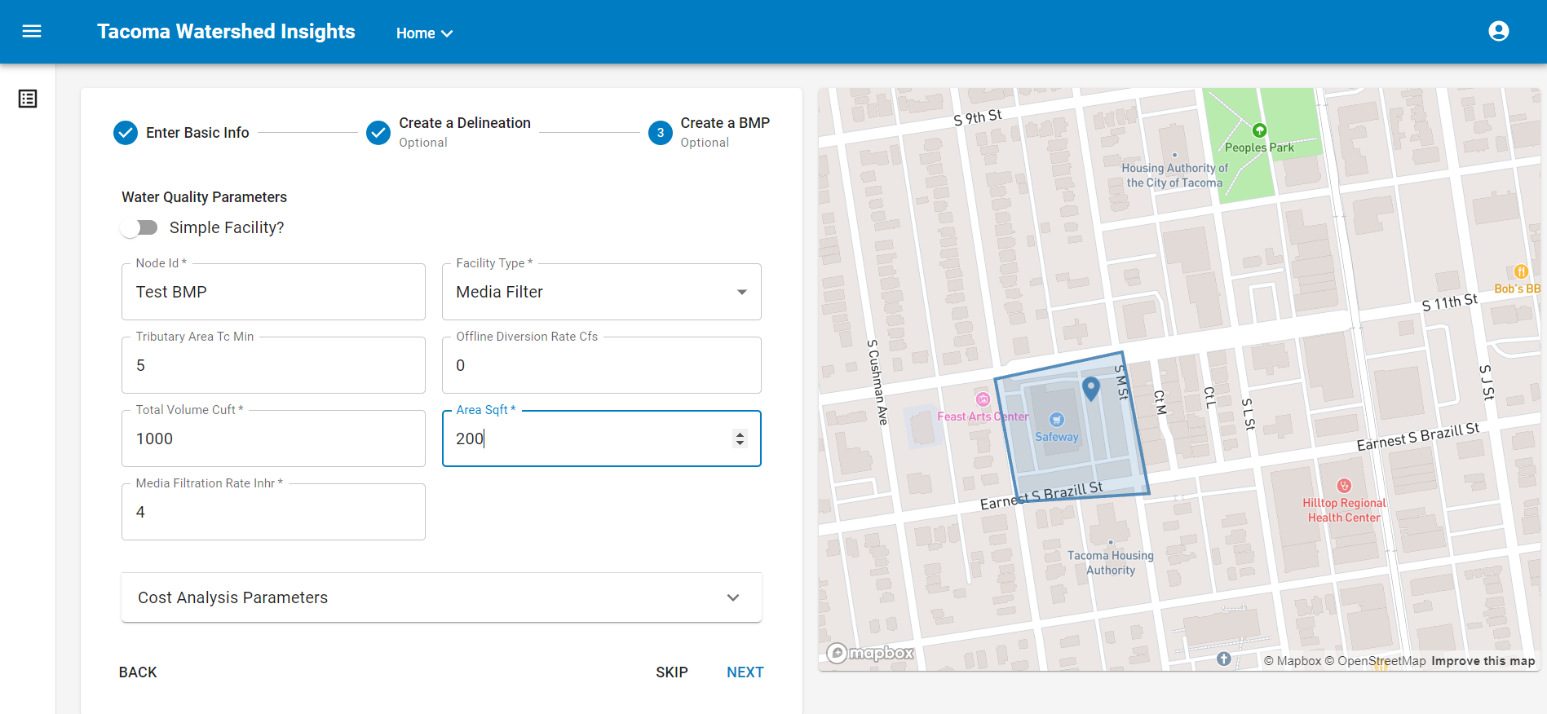
Scenario Design Process

Slide 22
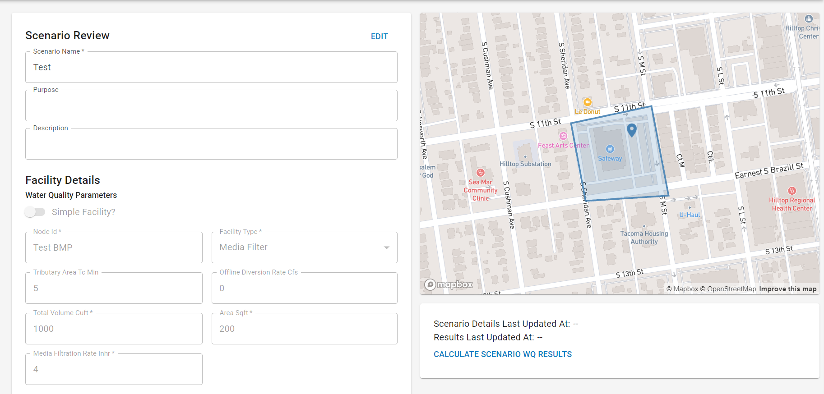
Scenario Design Process
Make edits and calculate results

Slide 23
Purpose and Process
Allows users to prioritize subbasins for stormwater improvements based on a number of goals and subgoals:
Clean Water Goal
Resilient Community Goal
Healthy Ecosystem Goal
Equity Goal
Subbasins are ranked using a pairwise algorithm - visual/tabular results are produced
Criteria and subbasin ranks can be downloaded for future use

Slide 24
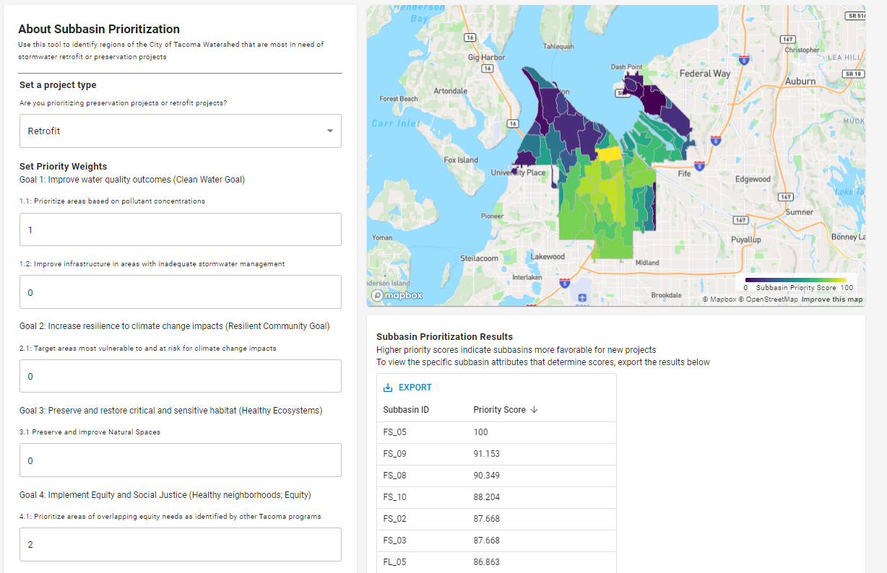
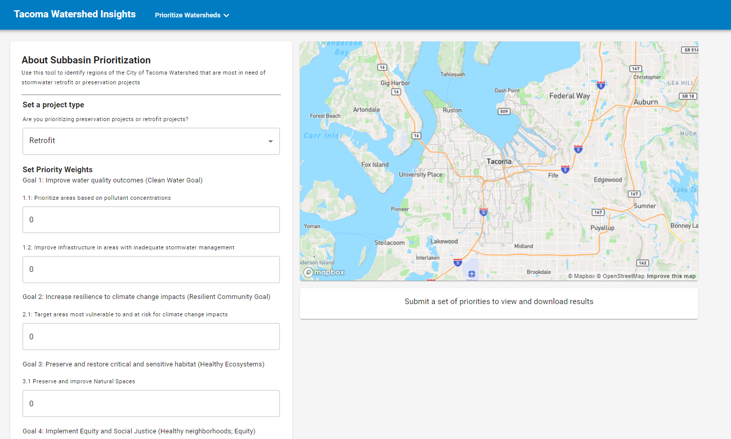
Different project types prioritize goals differently:
Retrofits are prioritized in high-runoff, high-pollutant areas subbasins
Preservations are prioritized in low-runoff, low-pollutant subbasins
After submitting priorities, subbasins are scored, and results can be visualized and downloaded
Enter priority scores for each subgoal
Scores of 0 mean the subgoal is not considered
A subgoal with a score of 2 is considered twice as important as one with a score of 1

Slide 25
Data Integrations
Tacoma GIS (refreshed each morning)
BMP Facilities
BMP Facility Delineations
Subbasins (and static subbasin metrics forthcoming)
TNC in Washington Stormwater Heatmap
POC concentration
runoff depth (4 climate epochs)

Slide 26
Data Integrations
Changeable data
BMP Facility modeling attributes (e.g. % capture performance, size)
BMP Facility cost attributes (e.g., capital cost)
Scenarios
Delineations, facility attributes
Users & Permissions
Cost Settings (e.g,. Inflation rate)

Slide 27
Data Integrations
Calculated data
BMP Facility volume and load reductions
BMP Facility cost metrics
Delineation and Subbasin loading
Upstream and Downstream source control measures (sweeping and drain line cleaning for Foss Watershed)
Scenarios
Delineations, BMP Facility WQ, BMP Facility Cost

Slide 28
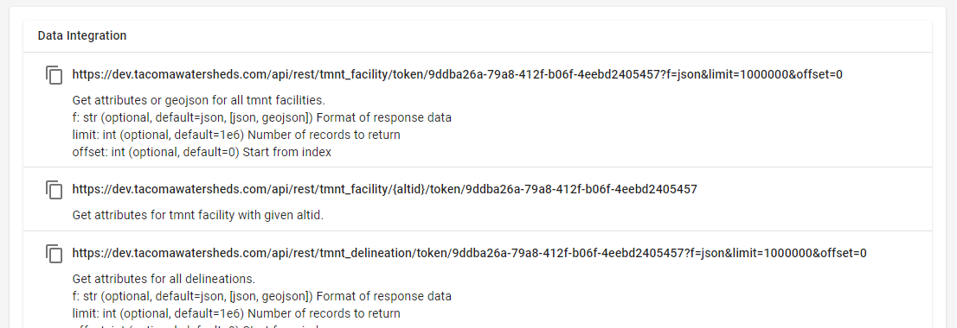
Data Integration
Access via api with token
TMNT Facilities: https://dev.tacomawatersheds.com/api/rest/tmnt_facility/token/<token>?f=geojson
Via User Profile

Slide 29
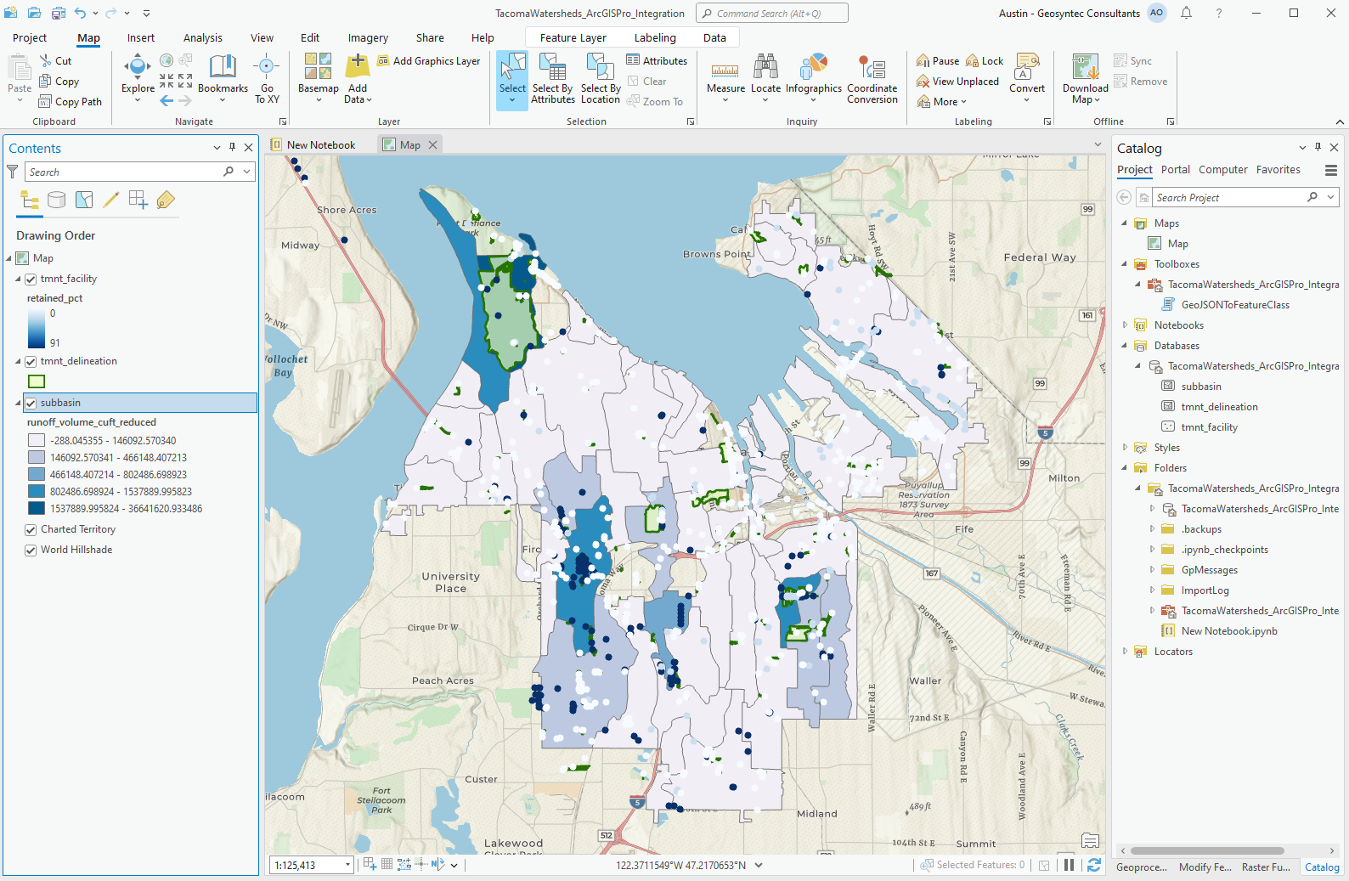
Data Integration GIS

